Slide 1

Data Challenge
Presented By: Kaitav Mehta

Slide 2
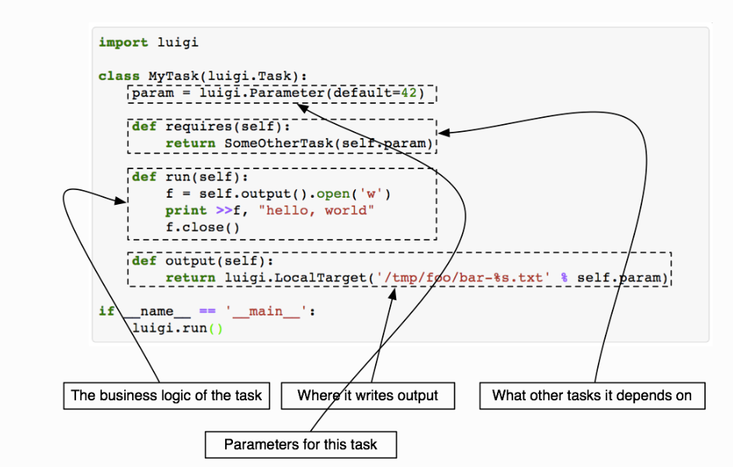
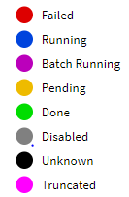
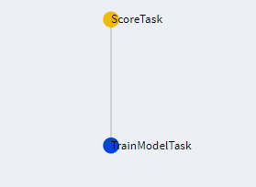
Luigi Framework
Take away on luigi:
Good at Batch programming
Reproducibility Matters
Ability to Resume Tasks
Dependency Graph and Visualization
Emphasis on Hadoop
Direct Development to Deployment

Slide 3
My Approach
Data Analysis
EDA
Cleaning
Pre-processing
Feature Engineering
One-hot encoder
Label encoder
Train and Evaluate Models
Logistic Regression Classifier
Cross Validation

Slide 4
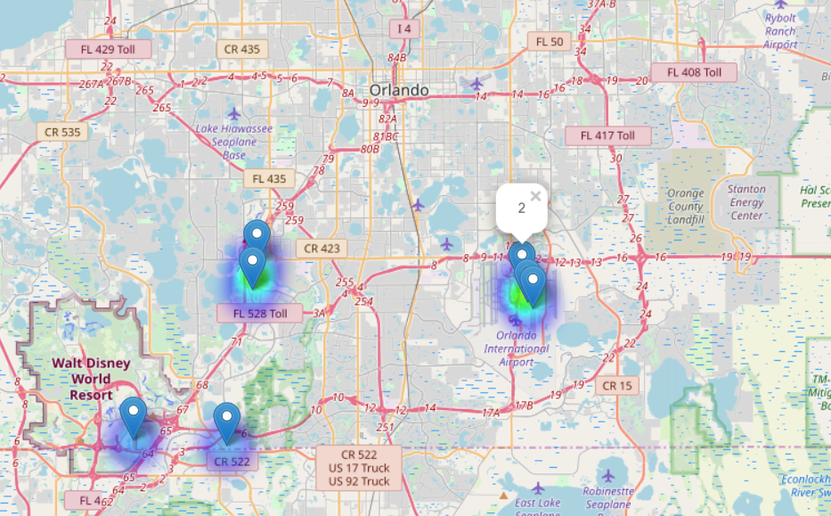
Exploratory Data Analysis
Plotting all geo-location with sentiments on map to visualize data

Slide 5
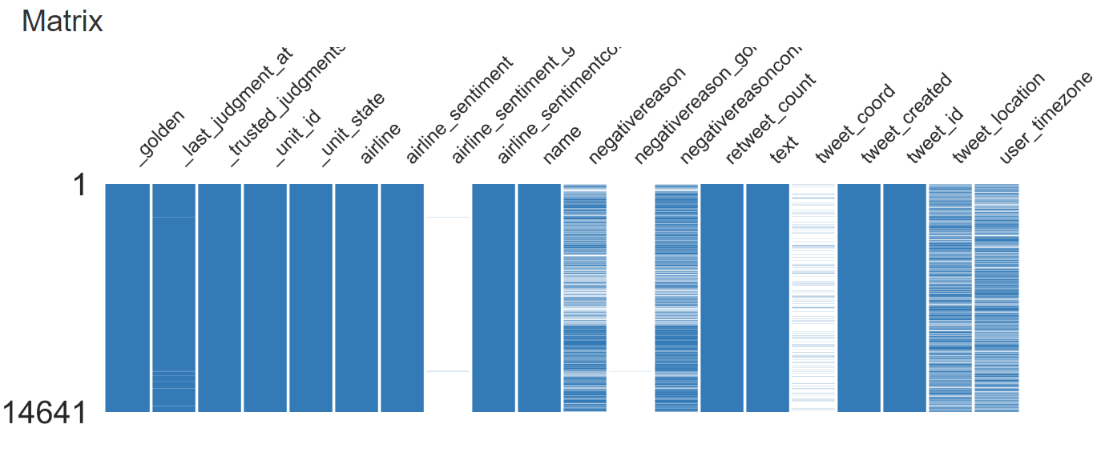
Analysing data visually, 93% of tweet_coord are missing
tweet_location is comparatively more than tweet_coord

Slide 6
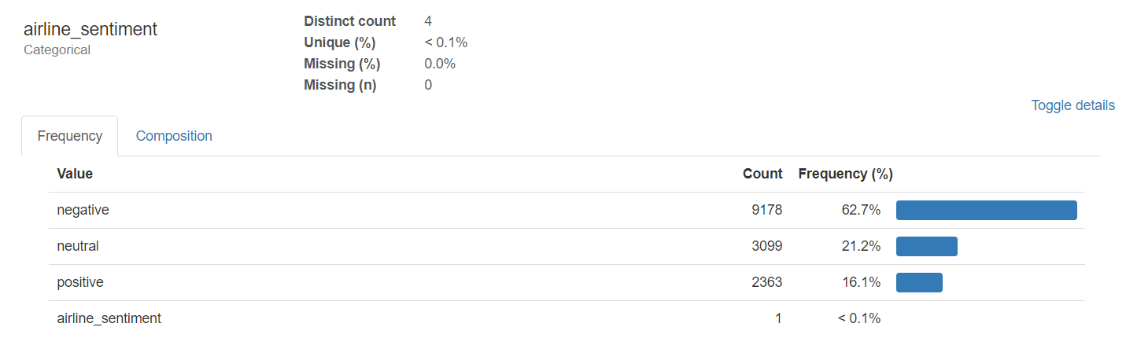
Negative Biased Sentiment

Slide 7
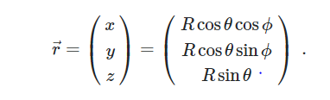

Cleaning and Pre-processing
To remove 93% of tweet_coord, I replace [0.0,0.0] with Nan in the data frame and used dropna to delete unwanted rows
To associate each geolocation with city, I have used 3Dimensional Euclidean distance to find the nearest city
Theta is latitude and Phi is longitude

Slide 8


Feature Engineering
To use city as training feature for the model it is required to convert text data to numerical format
I tried both label encoder and one hot encoder
One hot encoder performs better when there are many columns
But compared to the data points(855), the features(293) are very huge
Need to use other data points which were dropped initially

Slide 9
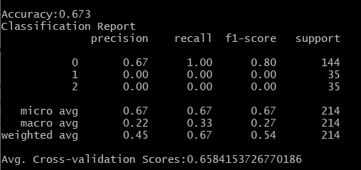
Logistic Regression for Multi Class Classification

Slide 10

S/D considerations
Readable code with comments
Reproducible results
Used cross validation to validate quality of model
Logging accuracy and classification report of model

Slide 11
What I would add ?
Using tweet_location column to add more data for training and testing
Scale features by adding a model to predict geo-location based on tweets using a CNN

